Slide 1
Regression Modeling
of Tetouan city
power consumption
CBD 2214: Assignment 1
Submitted by Group 6

Slide 2
Explanation of the Dataset
This dataset is related to power consumption of three different distribution networks of Tetouan city which is located in north Morocco.
Data Set Characteristics: Multivariate, Time-Series
Attribute Characteristics: Integer, Real
Number of Instances: 52417
Number of Attributes: 9
Collected from the UCI Repository: UCI Machine Learning Repository: Power consumption of Tetouan city Data Set
Provided by : Abdulwahed Salam, Abdelaaziz El Hibaoui, Faculty of Sciences, Tetouan, Morocco, Abdelmalek Essaadi University, Sallam.ye '@' yahoo.com, hibaoui '@' uae.ma

Slide 3
Attribute Information:
Data was collected from January 1, 2017 to December 21, 2017 in 3 zones of Tetouan City simultaneously with 10 minutes interval
Date Time: Each ten minutes.
Temperature: Weather Temperature of Tetouan city.
Humidity: Weather Humidity of Tetouan city.
Wind Speed of Tetouan city.
general diffuse flows
diffuse flows
power consumption of zone 1 of Tetouan city.
power consumption of zone 2 of Tetouan city.
power consumption of zone 3 of Tetouan city.

Slide 4
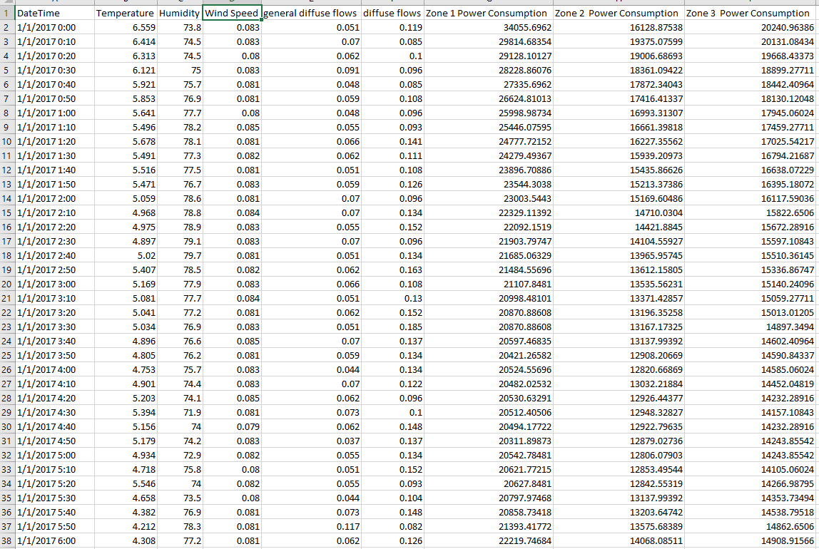
Data review

Slide 5
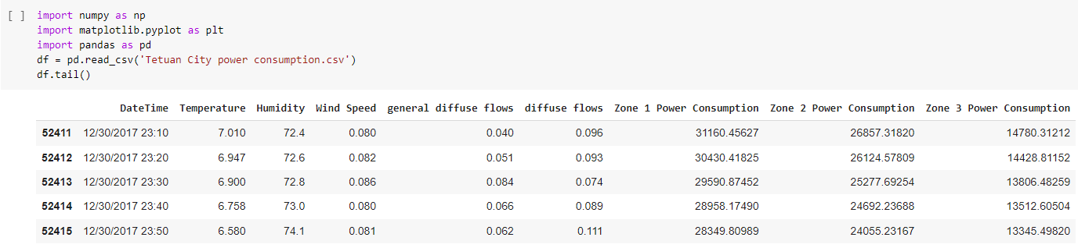
We used the pandas library in the python for visualising the “Tetouan City power consumption.csv” file into a dataframe.
We used the numpy and matplotlib libraries to plot the figures
The last 5 rows are shown here

Slide 6
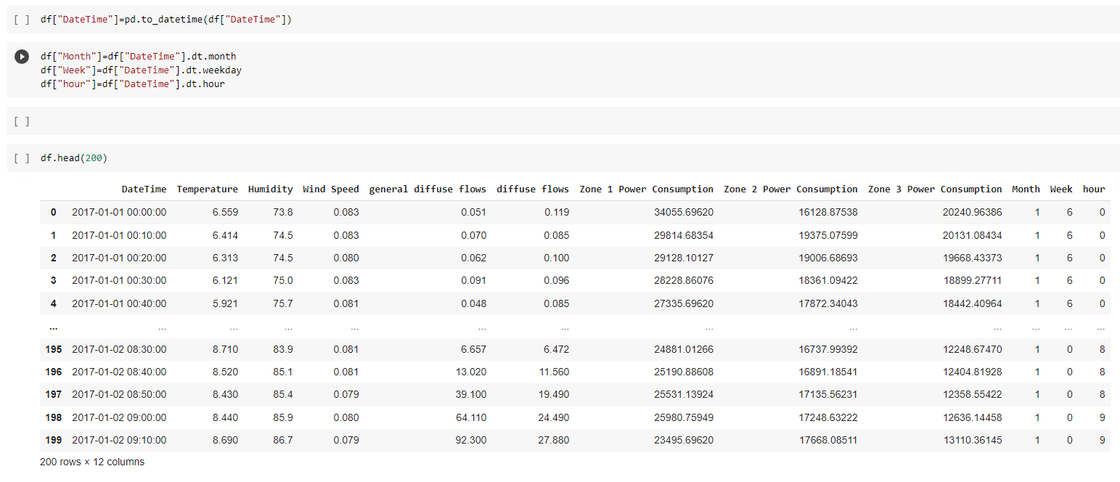
Data Preparation
The time series data in the “DateTime” column was converted into “hour”, “Week” and “Months”

Slide 7
Data Visualization
The power consumption in the 3 zones were plotted against “hour”, “Week” and “Month”
The “hour” vs all three zones were compared
The “Week” vs all three zones were compared
The “Month” vs all three zones were compared
It was observed that the “DateTime” which was converted “hour”, “Week” and “Month” to had the most contribution to the variation in the power consumption compared to any other factors like the “Temp”, “Humidity”

Slide 8
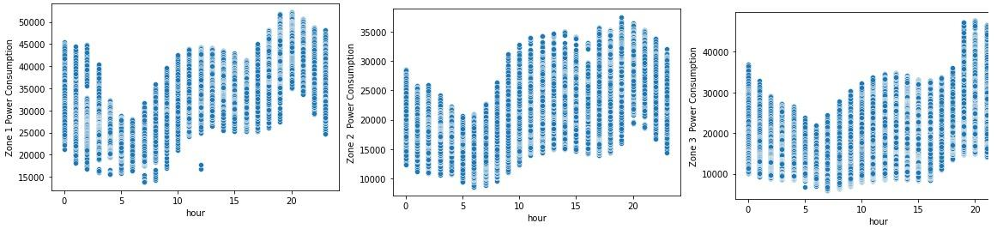
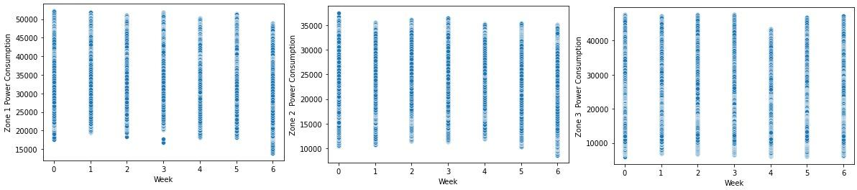
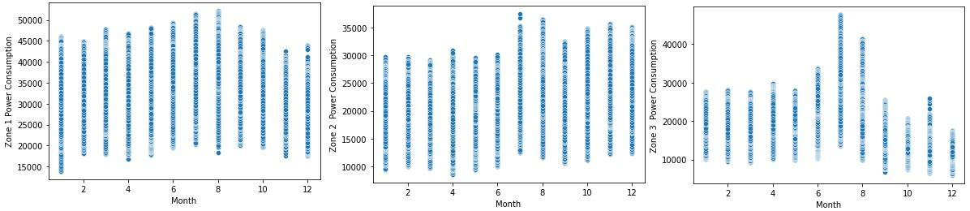

Slide 9

Root Means Square Error (RMSE)
Root Mean Square Error(RMSE) or Root Mean Square Deviation(RMSD) is a type of standard deviation method of the residuals more likely prediction errors.
Residuals are a measure of how distant they are from regression line data points; RMSE is a estimate of how spread out these residuals are.
It tells us how concentrated the data is around the line of best fit.

Slide 10
Algorithms used
We have used three machine learning algorithms in our assignment as following:
Linear Regression
Support Vector Machine (SVM)
Random Forest Regression

Slide 11
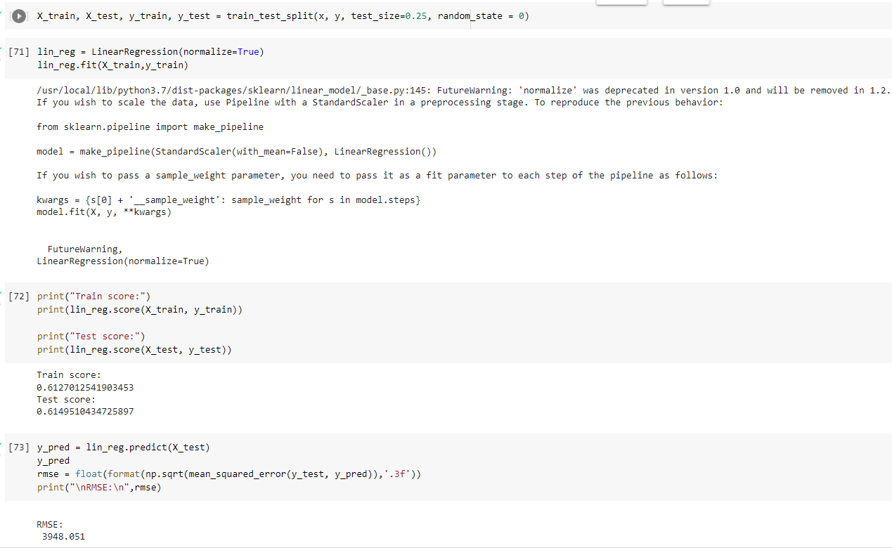
Linear Regression

Slide 12
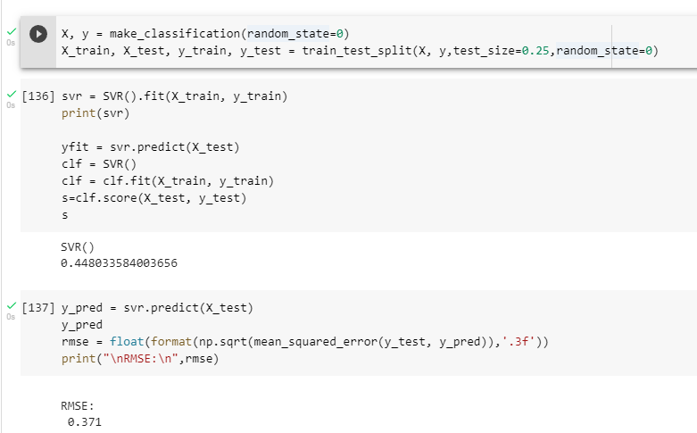
SVR

Slide 13
Random Forest Regression
Test and train split : 2:8
N estimators : 20
We tried multiple cases to get the better results as following:

Slide 14
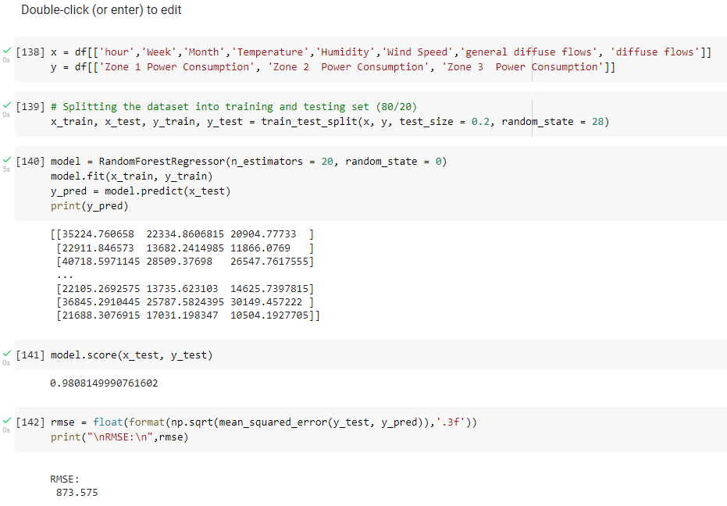
Case 1:

Slide 15
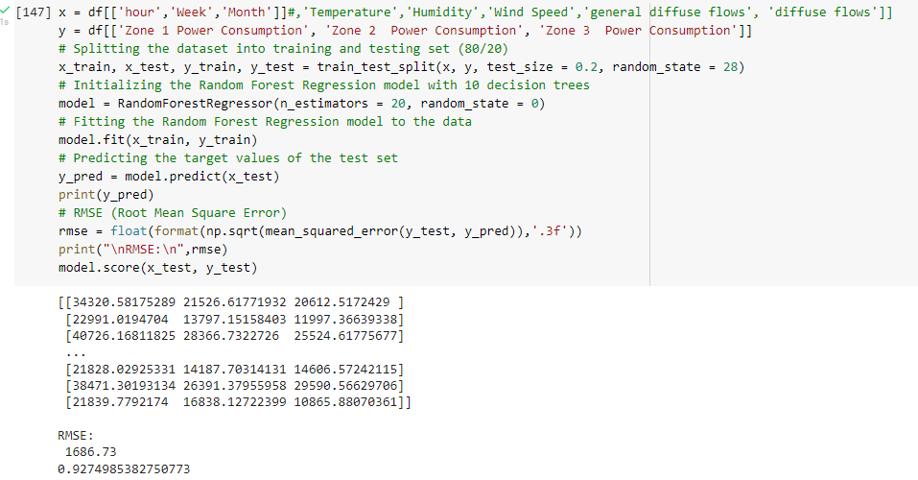
Case 2:

Slide 16
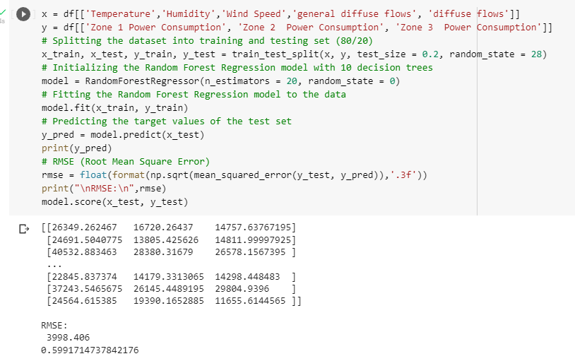
Case 3:

Slide 17
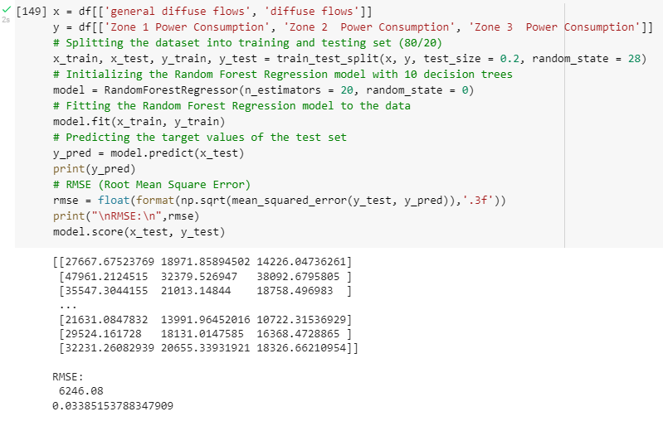
Case 4:

Slide 18
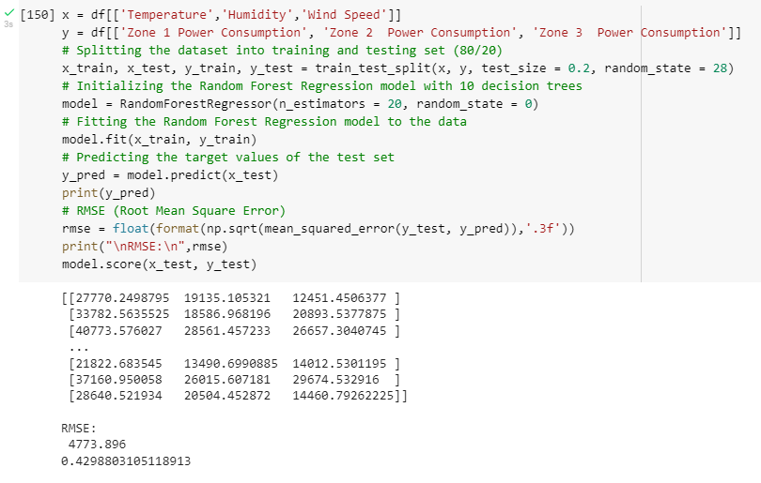
Case 5:

Slide 19
Conclusion:
The best algorithm was random forest where we had 98% accuracy in case 1.
Whereas linear regression gave us 61% and SVR 44%.

Slide 20
References
Scikit-learn.org., sklearn.ensemble.RandomForestRegressor, https://scikit-learn.org/stable/modules/generated/sklearn.ensemble.RandomForestRegressor.html
Salam, A., & El Hibaoui, A. (2018, December). Comparison of Machine Learning Algorithms for the Power Consumption Prediction:-Case Study of Tetouan cityâ€“. In 2018 6th International Renewable and Sustainable Energy Conference (IRSEC) (pp. 1-5). IEEE.â€

